Slide 1

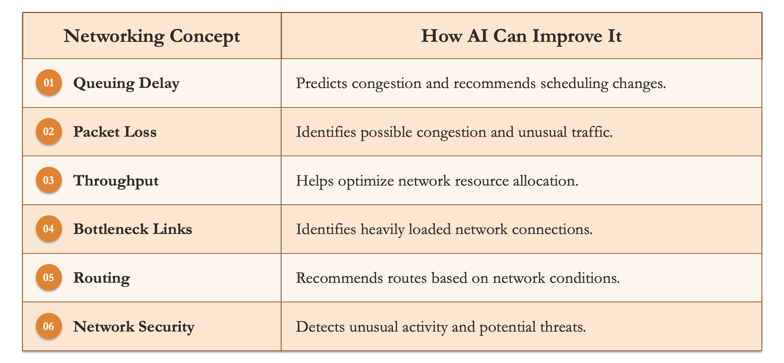
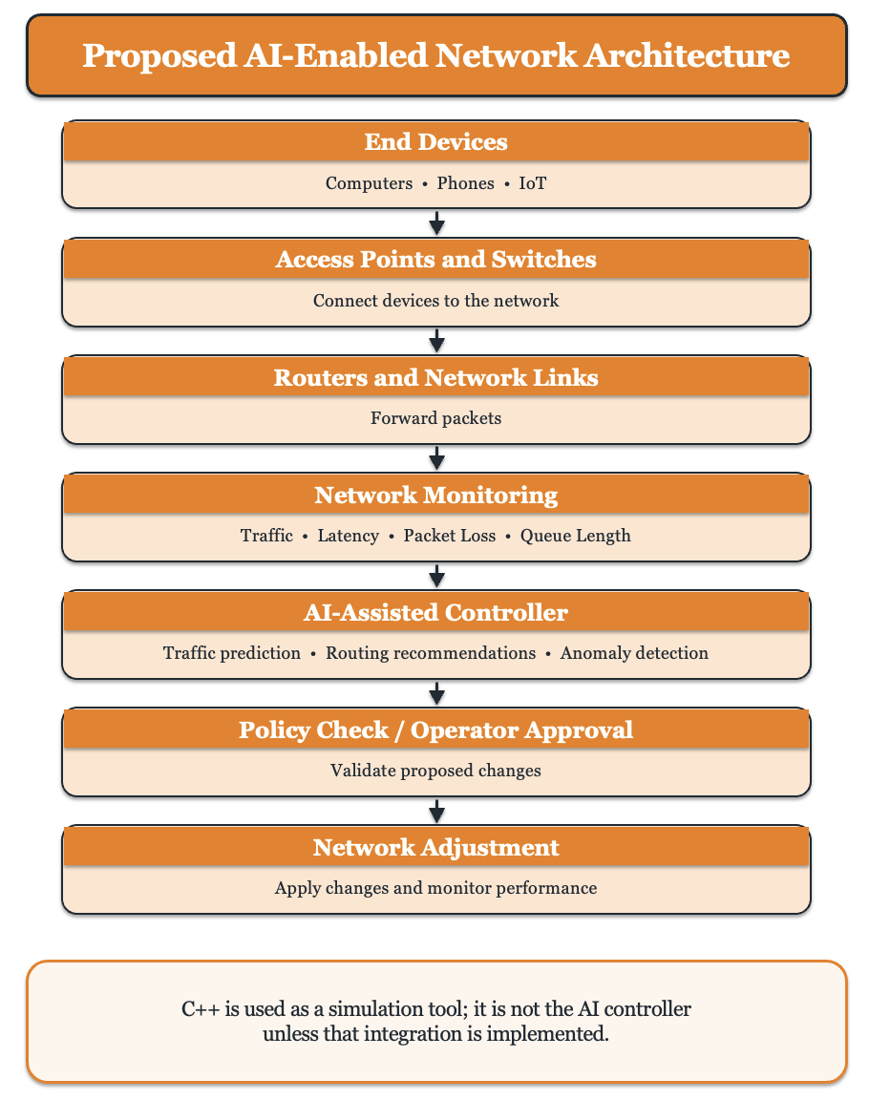
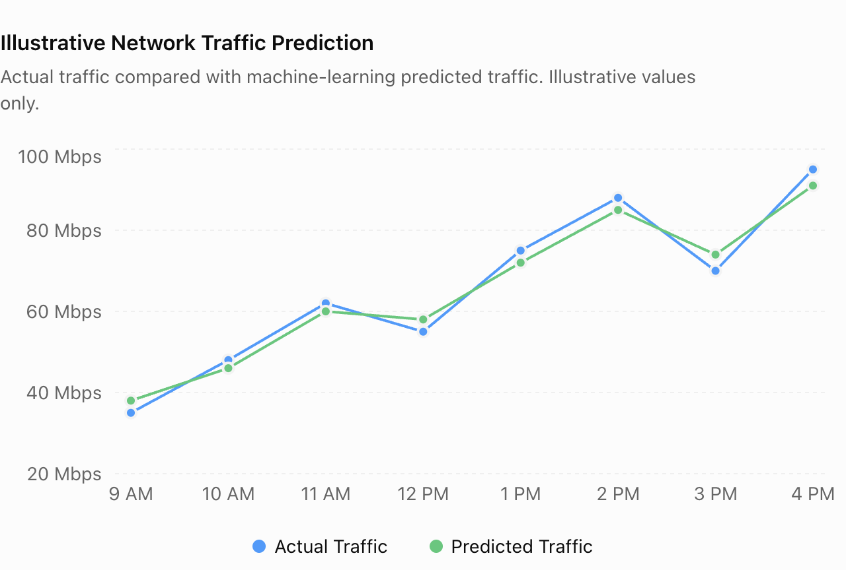


Artificial Intelligence for the Future of Computer Networking
Arya Desai
Faculty Advisor: Dr. Victor Govindaswamy
Concordia University Chicago
Abstract
How AI Improves Networking
Connection to Networking Concepts
Benefits
Artificial Intelligence (AI) is transforming computer networking by enabling networks to analyze traffic patterns, predict congestion, detect security threats, and optimize resource allocation. Traditional networks often rely on predefined rules and manual configuration, making it difficult to respond quickly to changing traffic conditions. AI can help improve network performance, reliability, and security through data-driven analysis and decision-making.
This poster explores an AI-enabled network architecture that combines network monitoring, AI-based analysis, and automated control to improve traffic management, reduce delays and packet loss, and respond to potential threats. C++ can be used to simulate packet traffic and evaluate network performance, including latency, throughput, and packet loss, while Python and machine learning libraries support AI model development. Despite its potential, AI networking faces challenges related to data quality, computational costs, security, and the reliability of automated decisions. Addressing these challenges is essential for developing efficient, secure, and adaptive networks.
Traffic Prediction: Machine-learning models analyze historical and current traffic data to estimate future demand.
Intelligent Routing: AI can analyze network conditions and recommend routes based on traffic, delay, and available capacity.
Anomaly Detection: AI can identify unusual traffic patterns that may indicate faults or security threats.
Resource Allocation: AI can help allocate bandwidth and computing resources according to network demand.
C++ Simulation: A C++ program can model packet arrivals, queue lengths, and congestion. Unless a trained ML model is integrated, this simulation demonstrates networking behavior rather than AI itself.
Lower latency and reduced network congestion.
Improved throughput and resource utilization.
Better network reliability and fault detection.
Faster identification of potential security threats.
Support for large-scale networks, including IoT and 5G/6G.
Limitations and Challenges
Requires large amounts of reliable training data.
Privacy concerns related to network data collection.
Computational costs of running AI models.
Incorrect predictions may affect network performance.
Integration with existing network infrastructure can be complex.
Sample Result: Traffic Prediction
Machine-learning models can compare predicted network traffic with actual traffic measurements. This helps identify traffic patterns and estimate future network demand.
Current Status
AI techniques are already being explored and used in network traffic analysis and anomaly detection.
Research organizations are developing AI-assisted network management solutions.
Standards organizations such as IEEE, IETF, and 3GPP are working on technologies related to intelligent networking and network automation.
Research Problem
Future Impact
Modern networks experience changing traffic loads, congestion, packet loss, and security threats. These problems can increase delay, reduce throughput, and interrupt services. Traditional network management may react only after problems occur. AI can analyze network measurements and help predict possible problems, while C++ simulations can demonstrate how network conditions affect performance.
More autonomous and self-managing networks.
Real-time adaptation to changing traffic conditions.
Integration with 6G, edge computing, and cloud technologies.
Improved support for smart cities and connected vehicles.
More secure and reliable global communication networks.
The graph illustrates how machine learning can estimate future network demand by comparing predicted traffic with actual measurements. All values are illustrative.
Graph labels:
X-axis: Time (Hours)
Y-axis: Network Traffic (Mbps)
Blue: Actual Traffic
Green: Predicted Traffic
Key Networking Concepts
Conclusion
Latency: Time taken for data to travel.
Throughput: Amount of data delivered over time.
Packet loss: Data packets that fail to reach their destination.
Congestion: Excess traffic that slows network performance.
Routing: Selecting paths for data transmission.
Network security: Detecting and responding to threats.
Resource allocation: Distributing bandwidth and network capacity efficiently
Artificial Intelligence can improve the performance, security, and reliability of computer networks. By predicting congestion and analyzing traffic, AI makes network management more efficient. Despite challenges such as data quality, security, and cost, AI will play a key role in future intelligent networks.
Performance Evaluation
Experimental Methodology
The proposed approach can be evaluated using the following metrics:
Prediction Accuracy: How closely predicted traffic matches actual traffic.
Latency: Time required for data to reach its destination.
Throughput: Amount of data transferred successfully.
Packet Loss: Percentage of packets that fail to arrive.
Resource Utilization: Efficiency of network resource usage.
Contacts
Collect network traffic data and identify important performance metrics.
Prepare the data for analysis.
Apply machine-learning techniques to identify traffic patterns.
Generate predictions and compare them with actual traffic.
Evaluate network performance using latency, throughput, and packet loss.
Bioinformatics And Technology Laboratory (BAT Lab)
- Programming Application Implementation and Design (PAID)
Computer Science Department (CSC@CUC)
Member: Arya Desai
Advisor: Dr Visvasuresh (Victor) Govindaswamy
Email: Victor.Govindaswamy@cuchicago.edu
Address: Concordia Chicago University
7400 Augusta Street
River Forest, IL, 60305-1499
Technologies Used

